Slide 2
My growth
26% fat 89.4kg

Slide 3
Swedenborg

Slide 4
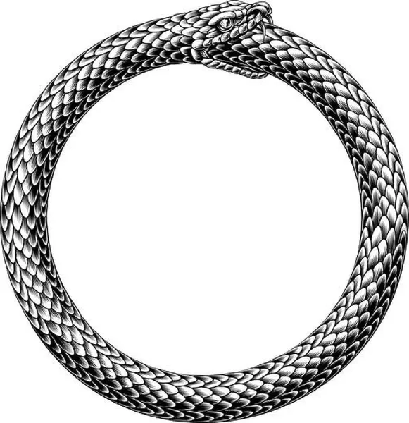
Saunas
The good morning Starts with a good evening

Slide 5
Discussions with Nikos:
Where does the reward function come from?

Slide 6
Trip to Scandinavia - Merging Christianity with Nordic Mythology
Personal journey (Carl Jung) Energy goes more inwards, which is a dying process
Staycation - reorient my PhD interests

Slide 7
Chaga - Never thought I would go to work with an axe

Slide 8
“Hunting” store

Slide 9
Different floors - different speciality

Slide 10
Stereotypical Finns - Alcoholics in the north
I don’t think it’s true
But…
By the middle of the second month I was brewing mead in my sauna

Slide 11
2025 Summer

Slide 12
What’s next?

Slide 13
Thank you
Nikos, Majeed, Tae, Ines, Emile, Taraneh, Thivyan, Andreas, Erman, Daniel, Dimitris, Selene, JC, Lise, Romy, Ritten, Giacomo
Stefan and Ilaria
Notes:
This deep feeling of gratitude and love is what motivates me to make this

